Slide 1
Customer Segmentation with K-Means for Targeted Marketing

Slide 2
Introduction
K-means clustering, an unsupervised machine learning algorithm, can effectively segment customers based on their purchase patterns, demographic information, and other relevant attributes. By identifying customer clusters, businesses can tailor marketing messages and product recommendations to specific segments, leading to improved customer engagement and conversion rates.

Slide 3
Understanding Customer Data
Data Overview: The customer dataset contains various attributes such as customer ID, gender, age, annual income, spending score, work experience, and family size.
Data Preprocessing: The categorical 'Gender' feature is encoded using LabelEncoder to convert it into numerical format suitable for numerical computations.

Slide 4
K-Means Clustering Implementation
Algorithm Implementation: The K-Means clustering algorithm is implemented using Python libraries. The algorithm iteratively assigns customers to clusters based on their similarity to cluster centroids.
Elbow Method: The Elbow Method is employed to determine an appropriate number of clusters (K). The Elbow Method plots the within-cluster sum of squares (WCSS) for different values of K. The optimal K value is typically identified by the 'elbow' point where the WCSS starts to decrease gradually.

Slide 5
Model Training and Evaluation
Model Training: The K-Means model is trained using the selected K value. The model assigns each customer to one of the identified clusters.
Silhouette Score: The silhouette score is used to evaluate the quality of the clustering. A higher silhouette score indicates better separation between clusters.

Slide 6
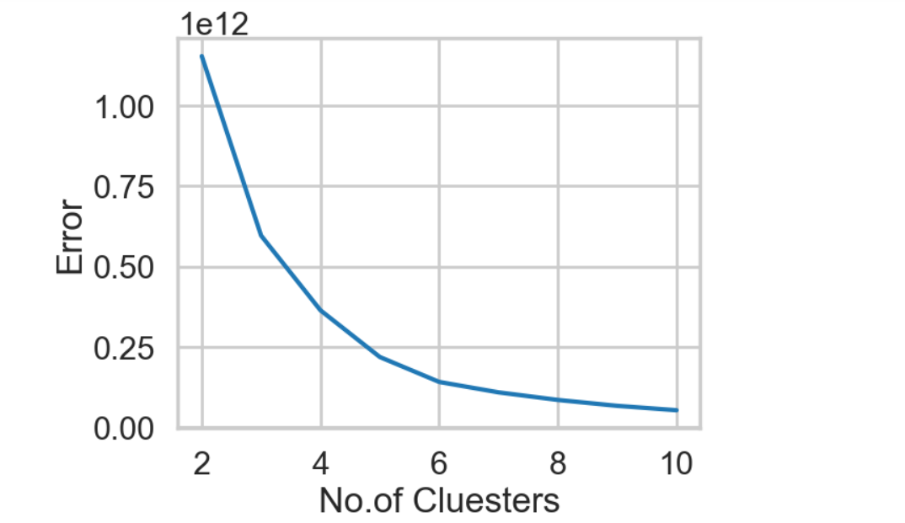
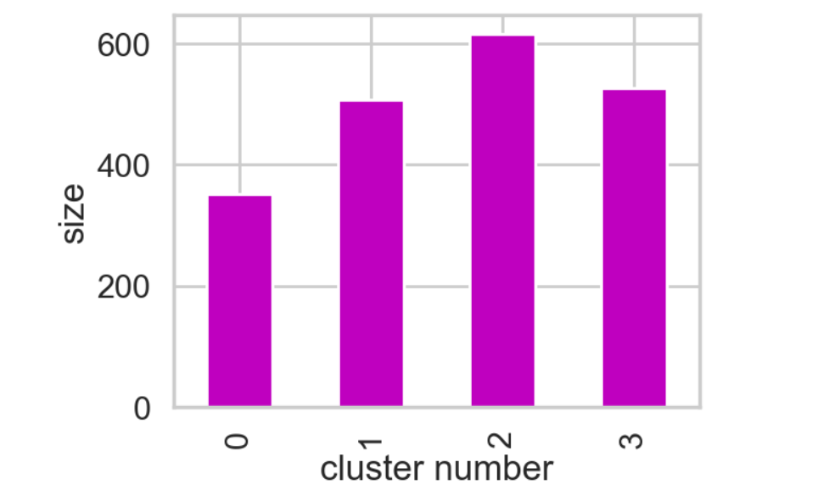
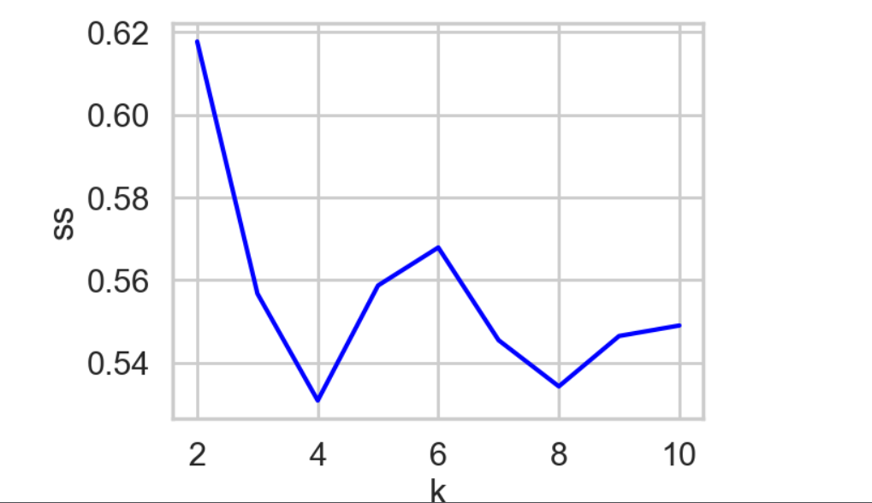
Customer Clustering and Visualization

Slide 7
Hyperparameter Tuning
Impact of K: The number of clusters (K) is a crucial hyperparameter that significantly affects the clustering results.
Fine-tuning: Different values of K are explored to identify the optimal number of clusters that best represent the customer segmentation.

Slide 8
Applications in E-commerce
Customer Segmentation: K-means clustering effectively divides customers into distinct segments based on their shared characteristics.
Targeted Marketing: By understanding the distinct characteristics of each customer cluster, businesses can tailor marketing messages and product recommendations to specific segments.
Personalized Shopping Experience: Personalized marketing campaigns and product recommendations can lead to improved customer engagement, satisfaction, and conversion rates.

Slide 9
Understanding K-Means Limitations
Sensitivity to K: The Elbow Method may not always provide a clear 'elbow' point, making it challenging to determine the optimal K value.
Assumptions: K-means assumes that the data is well-structured and that the clusters are approximately spherical.
Alternative Algorithms: Other clustering algorithms, such as Hierarchical Clustering, DBSCAN, and Spectral Clustering, may be more suitable for specific datasets.

Slide 10
Summary and Recommendations
K-means clustering is a powerful tool for customer segmentation in the e-commerce domain. It enables businesses to identify distinct customer groups and tailor marketing strategies accordingly.
Recommendations
Data Quality
Domain Expertise
Continuous Monitoring

Slide 11
Q & A

Slide 12
Thank You

